Slide 1
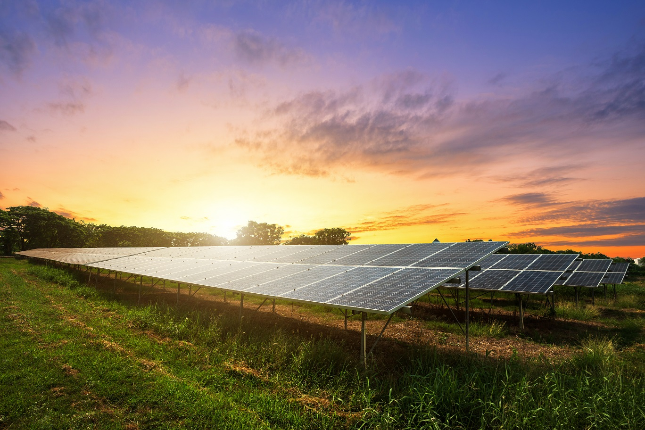

Turn Solar Into Savings

Slide 2


End to End Community Solar Project Development
Ground Mount Community Solar
1
We conduct a preliminary site assessment to gauge the technical feasibility of land.
2
We purchase/lease land for ground mount systems. Our average ground mounted system size is 2mW – 5mW across a minimum of 10 acres.
3
We work with the local utility and the county to meet all building code regulations and environmental requirements. We receive all conditional use permits and interconnection agreements.
4
We partner with an installation team in Illinois to complete the installation and energize the system.

Slide 3
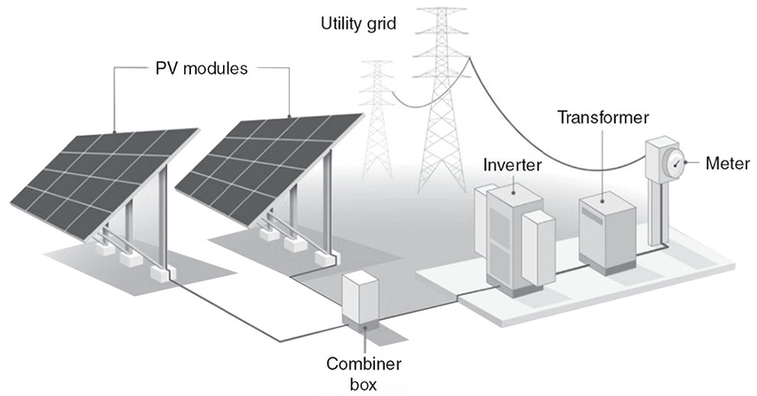
Project Details
Big Timber Solar Farm
Project Size
5mW
Tracker Type
Horizontal Tracker
Interconnecting Utility
Commonwealth Edison
Annual Power Yield
11,00,000 kWh (Enough to power ~1,300 homes annually)

Slide 4
Site Plot Summary
Big Timber Solar Farm
Summary
            20-foot-wide gravel access road
            Transformer pads and transformers
            Emergency vehicle turnarounds
            Number of inverters and location
            Identified wetlands from our wetland delineation report
            Wetland setback
            Medium voltage cable location
            Fencing type and height
            Panel setbacks
            Vegetation buffer and landscaping
            Point of Interconnection and poles
            Impervious calculations and quantities
            Ground coverage ratio

Slide 5
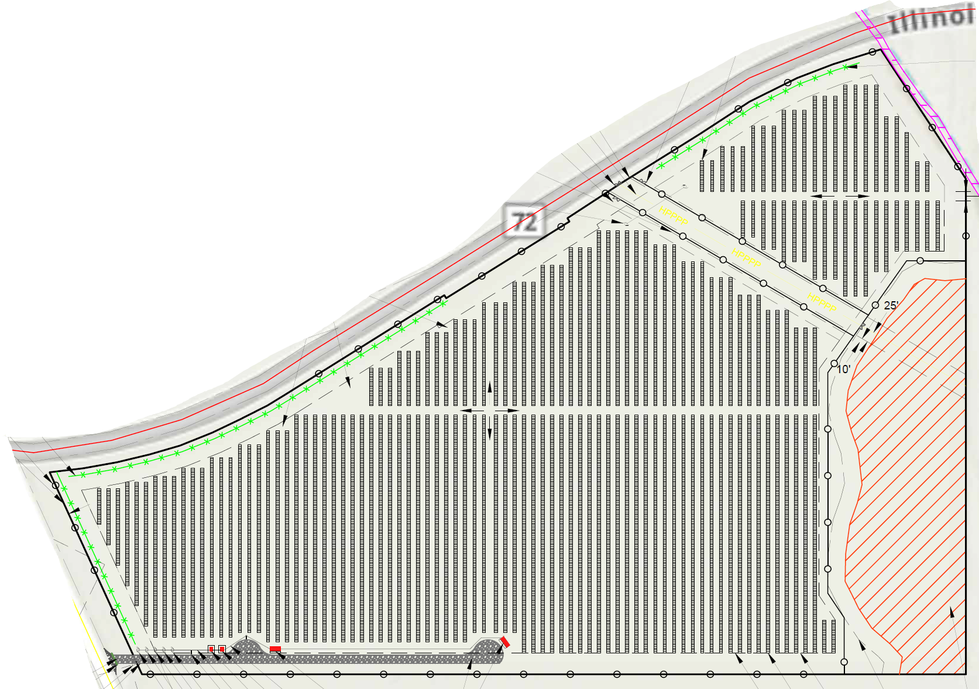
Vegetation Screening
            Vegetation screening will be added on the western and northern portion of the property
Notes:
Includes Location of 20 foot wide gravel access road on the eastern portion of the property, transformer pads and turnarounds for emergency vehicles near those transformer pads, number of inverters, identified wetlands from our wetland delineation report and our 40-foot floodzone setback, fencing type and height, panel setbacks, ground coverage ratio, vegetation buffer and landscaping, point of interconnection, and our impervious calculations and quantities in the chart on the right. All of these are labeled on the site plot and was shared in the permitting package.

Slide 6
Compliance: Findings Required for SUP Approval
Big Timber Solar Farm: Kane County Zoning Ordinance, Chapter 25-4-8-2
25-4-8-2-A
That the establishment, maintenance or operation of the special use will not be unreasonably detrimental to, or endanger the public health, safety, morals, comfort or general welfare.
                The project does not endanger the public health, safety, morals, comfort or general welfare in any way.
                As a source of renewable energy, the project does provide for construction jobs and increased tax revenues while preserving and enhancing the site’s value for future agricultural use when the project is decommissioned.
                25-4-8-2-B
                That the special use will not be injurious to the use and enjoyment of other property in the immediate vicinity for the purposes already permitted, nor substantially diminish and impair property values within the neighborhood.
                Using landscaping to enhance aesthetics, agricultural fencing to secure the perimeter, plus professional documentation of the minimal glare and noise associated project equipment, the project displays every consideration expected of a good neighbor.
                Numerous studies conducted by real estate analysts outside of the solar industry, including several projects, counties and townships in Illinois, have concluded that solar facilities do not have a negative impact on adjacent property values.
                25-4-8-2-C
                That the establishment of the special use will not impede the normal and orderly development and improvement of surrounding property for uses permitted in the district.
                Renewable energy remains a long-term economic development goal for both Kane County and the State of Illinois. Included as part of planning and marketing campaigns, the presence of energy facilities can spur a local economy while still providing for continued incremental growth in accordance with established comprehensive plan goals.

Slide 7
Compliance: Findings Required for SUP Approval
Big Timber Solar Farm: Kane County Zoning Ordinance, Chapter 25-4-8-2
25-4-8-2-D
That adequate utility, access roads, drainage and/or other necessary facilities have been or are being provided.
                The project site plan provides for a single access road featuring adequate turnarounds for maintenance and emergency vehicles.
                Prior to construction permitting, a drain tile survey will be commissioned to establish a baseline of existing onsite drainage facilities; in accordance with our drain tile mitigation plan and formal AIMA agreement with IDOA, all damaged tiles will be repaired or replaced during construction, and later, during decommissioning.
                25-4-8-2-E
                That adequate measures have been or will be taken to provide ingress and egress so designed as to minimize traffic congestion in the public streets and roads.
                Post-construction activity, no traffic congestion will be produced by the project. With minimal need generated by maintenance vehicles visiting the site, no onsite parking facilities are provided. Construction parking will be restricted within the site.
                Remote equipment monitoring eliminates the need for onsite employees and routine maintenance by either landscape or equipment is limited to 6-8 visits throughout the year.
                25-4-8-2-F
                That the special use shall in all other respects conform to the applicable regulations of the district in which it is located, except as such regulations may in each instance be modified by the county board pursuant to the recommendations of the zoning board of appeals.
                A thorough analysis of the project’s design will reveal initial compliance with all applicable zoning regulations, subject to further review and modification to meet reasonable conditions of approval imposed by Kane County.

Slide 8
Local Jurisdictional Outreach
Big Timber Solar Farm
Summary
Beginning in August 2024, our staff began ongoing outreach to local jurisdictions within 1 ½ miles of the project site; sharing a preliminary site plan package and attempting to solicit comments and input into the project design. While comments were not always forthcoming, below is summary of the jurisdictions contacted and comments we received.
            Rutland Township – initial e-mail contact with supervisor regarding road jurisdiction & permit requirements; follow-up e-mail and telephone contact to further inform the discussion surrounding BTSF.
            Village of Gilberts – initial e-mail contact w/Village staff; follow-up e-mail and telephone contact to further inform the discussion of issues related to BTSF. no response; subsequent resolution submitted to the ZBA/County Board
            Village of Pingree Grove – e-mail contact; no response; follow-up e-mail and telephone contact to further inform the discussion surrounding BTSF.
            Rutland-Dundee Fire Protection District – e-mail contact with Fire Marshal Curtis Kramer; comments or questions noted concerning fire protection, equipment, access, and emergency planning; a detailed written response prepared and submitted.
            Plato-Rutland Drainage District – e-mail contact; no response; follow-up e-mail and telephone contact to further inform the discussion on potential drainage issues surrounding BTSF..

Slide 9
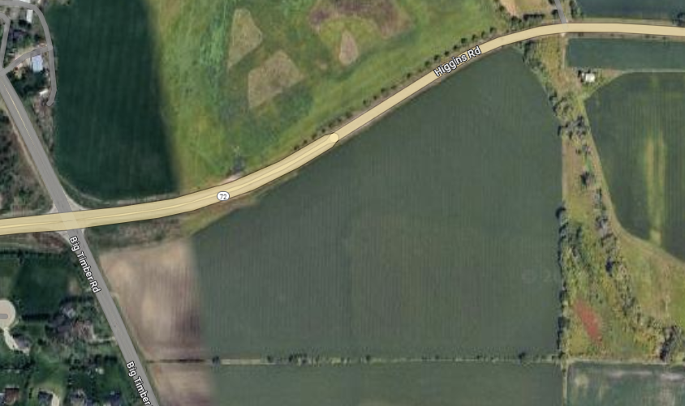


Viewship
Big Timber Solar Farm
View looking Southeast on Higgins (RT 72)

Slide 10
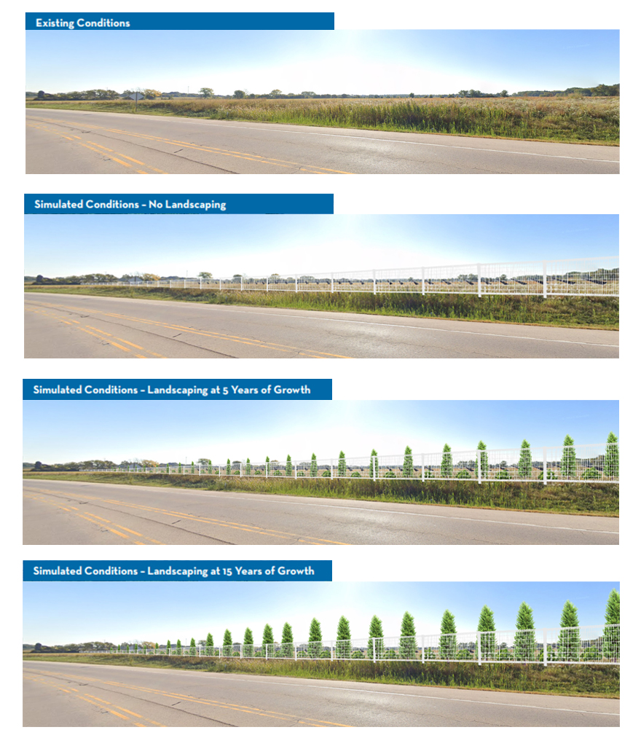
Potential View looking Southeast on Higgins (RT 72)

Slide 11


Viewship
Big Timber Solar Farm
View looking Northeast on Big Timber Rd.

Slide 12
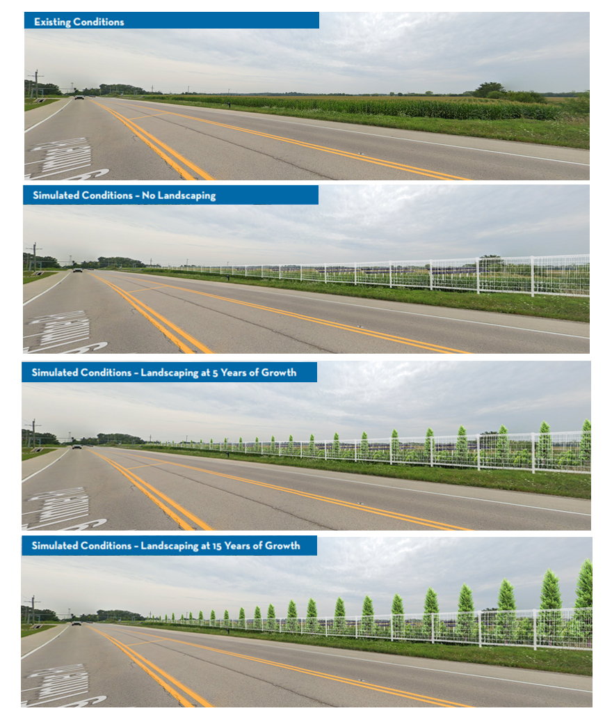
Potential View looking Southeast on Higgins (RT 72)

Slide 13
Tax Revenue
Big Timber Solar Farm
Tax Revenue
            Standard assessment value per mW installed (Public Act 100- 0781), project will generate about $1,077,990 in property tax revenue across project life (35 year)
            https://tax.illinois.gov/content/dam/soi/en/web/tax/localgovernments/property/documents/commercialsolarenergysystemsvaluation.pdf
District | Tax Rate | Current Annual Tax Revenue | Future Annual Tax Revenue | Net Increase
DUNDEE SCHOOL DISTRICT 300 | 5.04% | $1,890.48 | $22,684.76 | $20,794.27
RUTLAND DUNDEE FIRE DIST | 0.59% | $221.91 | $2,662.74 | $2,440.83
ELGIN COLLEGE 509 | 0.42% | $157.95 | $1,895.35 | $1,737.40
KANE COUNTY | 0.31% | $116.15 | $1,393.78 | $1,277.63
FOX RIVER VALLEY PUBLIC LIBRARY | 0.16% | $60.85 | $730.19 | $669.34
KANE FOREST PRESERVE | 0.13% | $48.39 | $580.69 | $532.30
RUTLAND TWP ROAD DIST | 0.05% | $19.15 | $229.78 | $210.63
RUTLAND TOWNSHIP | 0.03% | $11.57 | $138.82 | $127.25
TOTAL | 6.73% | $2,526.46 | $30,316.10 | $27,789.64

Slide 14
Drainage
A Stormwater Permit will be applied for as part of the construction permit process. Final engineering will be reviewed with Kane County Water Resources to assure compliance with the Stormwater Ordinance prior to permit issuance.
The project will provide a net benefit to the watershed. There will be no adverse stormwater impact or expense to any neighbors or downstream waterways.
Over 98% of the site will be planted with pollinator mix, creating less runoff than row crops.
Overall runoff curve numbers (lower = less runoff)
  Impervious – 98
  Row Crops – 77
  Pollinators – 71
  Composite (0.54 x 98 + 45.92 x 71)/46.46 = 71.4 < 77

Slide 15
Drainage
Stormwater Management will be provided per the Kane County Stormwater Ordinance.
Project is adding about 0.54 acres of new impervious surface (access roads, turn arounds, equipment pads). Individual solar panels create disconnected impervious area that does not impact the runoff.
Stormwater Detention is not required as the new impervious area is under the threshold
Stormwater Mitigation/BMP’s will be provided per the Kane County Stormwater Management Ordinance to mitigate for this new impervious surface
  “Leaky Berms” will be included in the final engineering to store and infiltrate runoff from the access roads
A Watershed Benefit Measure will be provided as an additional measure
  Pollinator seed mix provides dual benefit of runoff reduction and meets state siting requirements
  While not required, the nature of this project lends itself to watershed improvement

Slide 16
Overall Drainage
The site drains to the east, toward Tyler Creek. There is no offsite flow tributary to the project.
All existing overland flood routes will be maintained.
Soil Erosion and Sedimentation Control measures will prevent silt from leaving the site
  Silt fence, vegetative buffers and temporary seeding
A drain tile survey will be completed as part of the construction permit process; damaged tiles will be repaired/replaced as needed.
100-year Floodplain has been identified at the southeast portion of the property. The proposed improvements will not have any adverse affects on the floodplain and there will be no fill within the floodplain boundary
No Wetlands have been identified on the property. There are known and mapped wetlands associated with the unnamed tributary of Tyler Creek to the west. The proposed improvements will not have any adverse affects on any wetlands or wetland buffers

Slide 17
Compliance: Findings Required for SUP Approval
Big Timber Solar Farm: Kane County Zoning Ordinance, Chapter 25-4-8-2
25-4-8-2-A
      That the establishment, maintenance or operation of the special use will not be unreasonably detrimental to, or endanger the public health, safety, morals, comfort or general welfare.
                25-4-8-2-B
                That the special use will not be injurious to the use and enjoyment of other property in the immediate vicinity for the purposes already permitted, nor substantially diminish and impair property values within the neighborhood.
                25-4-8-2-C
                That the establishment of the special use will not impede the normal and orderly development and improvement of surrounding property for uses permitted in the district.
25-4-8-2-D
That adequate utility, access roads, drainage and/or other necessary facilities have been or are being provided.
                25-4-8-2-E
                That adequate measures have been or will be taken to provide ingress and egress so designed as to minimize traffic congestion in the public streets and roads.
                25-4-8-2-F
                That the special use shall in all other respects conform to the applicable regulations of the district in which it is located, except as such regulations may in each instance be modified by the county board pursuant to the recommendations of the zoning board of appeals.

Slide 18
Invest in a future worth living

Slide 19
Project Details
Big Timber Solar Farm
Setbacks
                All setbacks meet County ordinance
                Residential setback meets County UDO requirements.
                Vegetation Screening
                All screening meets County UDO requirements.
                Landscape Plan is provided.
                Pollinator Friendly Habitat
                Soils beneath the solar array and buffer area will be seeded with a native pollinator friendly seed mix that comply with the Illinois Pollinator-Friendly Solar Site Act (525 ILCS 55/).
                With soils undisturbed beneath the site’s equipment, improved soil health and reduced erosion benefits fallow soil.
                Pollinator-friendly habitats help bees, butterfly, and other insects pollinate plants we rely on for food and other materials.
                Drain tile impacts
                Commence a drain tile survey immediately upon final approval, but prior to construction; a drain tile mitigation plan has been prepared.
                A signed Agricultural Impact Mitigation Agreement (AIMA) has been executed with the Illinois Department of Agriculture (IDOA).
                The AIMA requires us to maintain surrounding area subsurface drainage/drain tiles; promoting soil health through improved drainage.
Storm Water Management
                Site plan will fully comply with County’s Stormwater Management Ordinance.
                Stormwater Management Permit required prior to the issuance of construction permits.

Slide 20
Project Details
Big Timber Solar Farm
Grading
                Minimize removal of topsoil as much as possible
                Limited to access road, inverter pads, and any minor slopes
Tilt
                Max tilt will be < 20ft
Glare
                Glare study completed; provided to County – FAA Notice criteria tool
Construction
                Licensed structural engineer will certify the foundation design plans based on a geotechnical analysis.
                Contract an Illinois-registered Engineering, Procurement and Construction (EPC) contractor to build the facility.
                Comply with all applicable building, electrical and fire codes, including the National Electrical Code (NEC). All equipment used will be UL-certified.

Slide 21
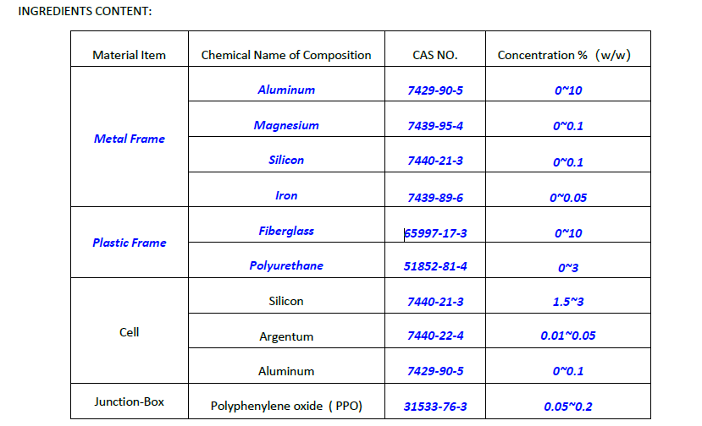
MSDS Report - Solar Panel

Slide 22
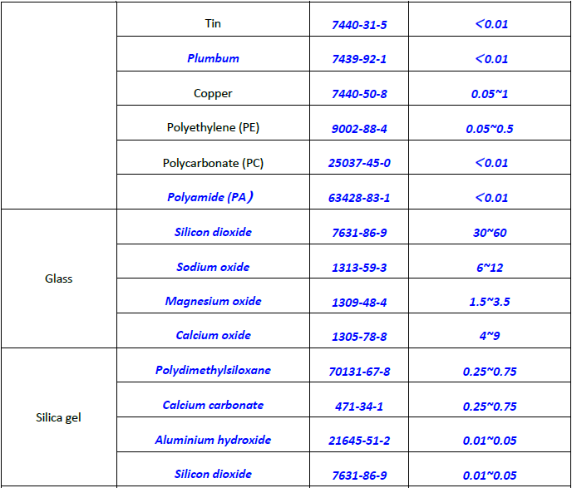
MSDS Report - Solar Panel

Slide 23
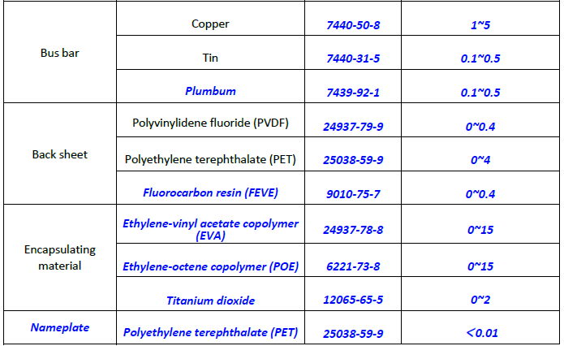
MSDS Report - Solar Panel

Slide 24
Mitigating Fire Risk
Big Timber Solar Farm
                Procedures & On-Site Safety
                PV Equipment markings to be weather resistant visible and legible
                Knox Box for facility entry to be located free and visible at front gate
                Emergency number for 24/7 remote shutoff service
                Main Service disconnect visible and free on all equipment pads
                Fire Safety road turnabout for access to large emergency vehicles to be implemented in facility design
                Comprehensive emergency services plan to be created with in conjunction with local emergency services
                Precautionary measures taken in case of an emergency scenario
                PV Modules are tested and certified by Underwriting laboratories (UL) & International Electrotechnical Commission (IEC)
                Onsite inverters to operate within acceptable limits to prevent exhaustion and overheating
                Transformers to operate within acceptable limits and thermal capacity to prevent exhaustion and overheating
                Inspections & Approvals
                Local Utility to inspect the DER facility prior to COD to ensure systems are properly installed
                Local fire protection district to inspect the facility to ensure safety measures are communicated in case of an onsite emergency
                County Engineers to inspect the elements of the facility prior to COD

Slide 25
Health Hazards
Big Timber Solar Farm
Only trained personnel shall have access to the solar facility. All trained personnel shall obey OSHA/Installation/Manufacturer Specification rules and regulations including:
Personal Protective Equipment
Hand & Power Tools
Fall Protection
General Safety Provisions
Manufacturers’ Equipment and Installation Manuals/Specifications
Warning signs & stickers
Living Next to a Solar Facility
There are no known causes or impacts to nearby residents
Electricity from solar panels and transmission to power grid emits extremely weak electromagnetic fields; posing virtually no degree of human risk according to the World Health Organization (WHO).
Exposure to weak electromagnetic fields has not been proven to impact human biology over time.

Slide 26
Employment
Big Timber Solar Farm
Employment
The construction of the facility will require approximately 20-40 employees, over a construction period lasting 4 to 6 months (weather permitting). Typical employment will include equipment operators, electricians, fence installers, laborers and construction managers; primarily drawn from the local workforce (if available) and paid the prevailing wage standard.
Once construction is complete, there will be 3 to 5 employees periodically visiting the site to perform operational maintenance on the equipment – in addition to offsite, remote monitoring 24/7/365. Routine landscaping will be provided on a regular basis throughout the life of the project.

Slide 27
Operations and Maintenance
Big Timber Solar Farm
Maintenance will include inspection of all equipment, vegetation control, and fence inspections. Maintenance of grounds keeping shall include mowing, reseeding, and weed management practices.
Preventative Maintenance
            Component inspection - scheduled visits based on manufacturer recommendations (generally 1 – 2 visits per year).
            Module cleaning; not expected due to average monthly rainfall in the area.
Corrective Maintenance
            Remote diagnosis via SCADA, or Data Acquisition System (DAS) .
Vegetation
            Vegetation beneath/between solar panels will be maintained to keep growth below the solar panels’ low edge at maximum tilt angle.
            If chemical control is to be applied, it will be in accordance with Illinois Noxious Weed regulations and by a licensed pesticide applicator.

Slide 28
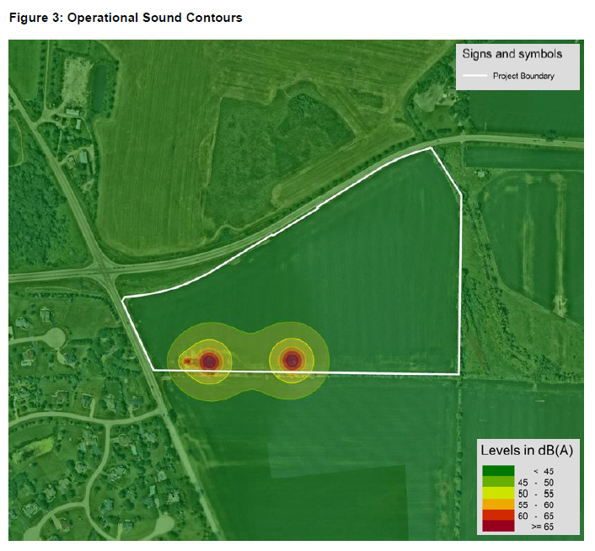
Noise Pollution
Big Timber Solar Farm
            Conclusions
            The proposed solar photovoltaic project site is less than a mile west of Gilberts, approximately 1.5 miles southeast of Huntley, and 2.5 miles east of Hampshire. The site is generally located south of Higgins Road (IL Route 72), east of Big Timber Road (County Road 21), and southwest of Jane Addams Memorial Tollway (I-90). Additionally, Union Pacific (UP) railroad tracks are located approximately 1 mile east of the project site.
            After modeling and analyzing the anticipated operational sound levels throughout the proposed solar site, it was determined that noise mitigation measures are not needed at this time since the anticipated operational sound levels will remain below the IPCB allowable noise levels at the surrounding Class A land uses during daytime hours.

Slide 29
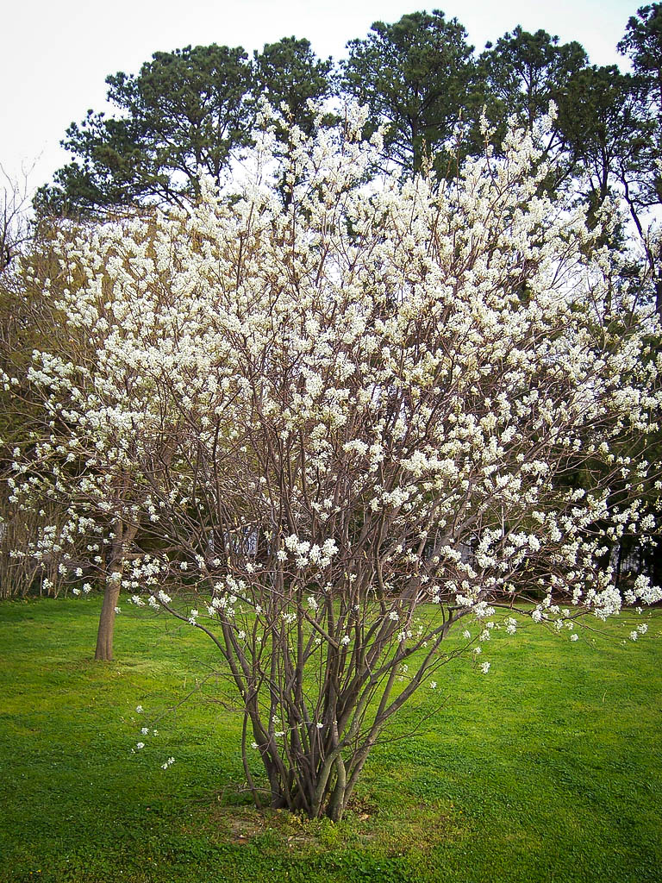
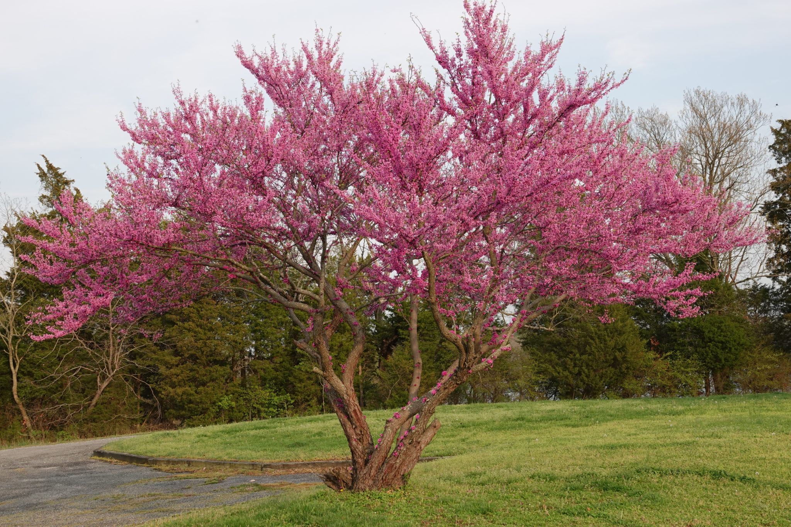
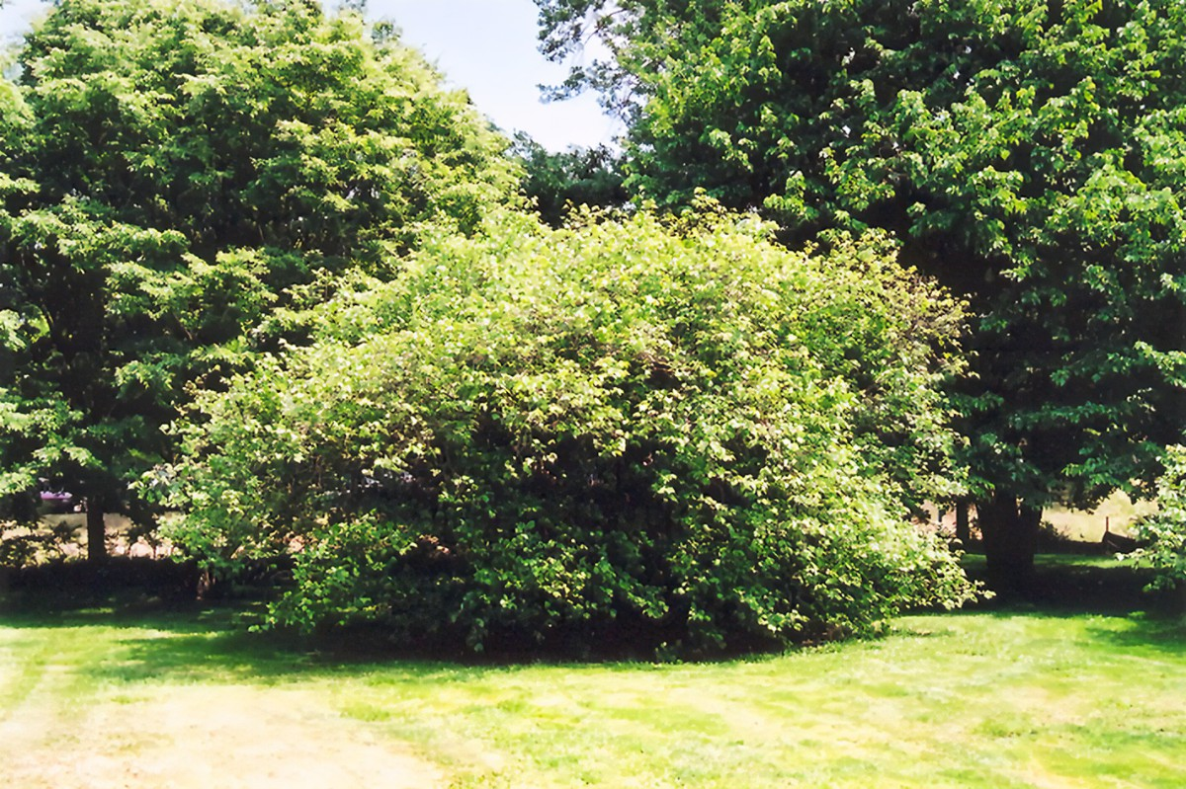
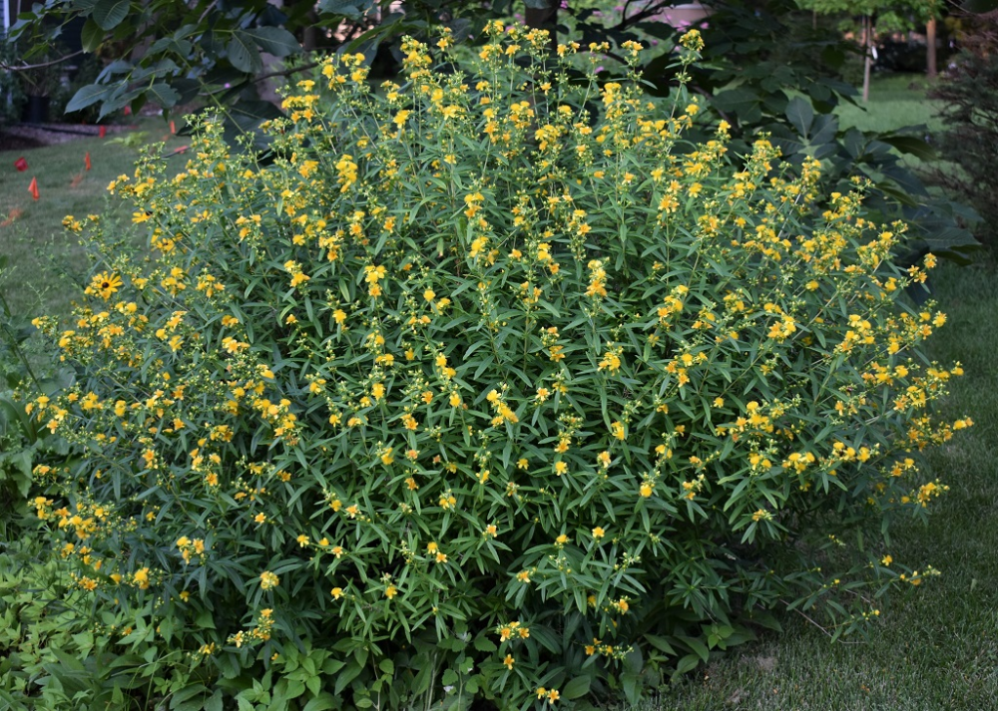
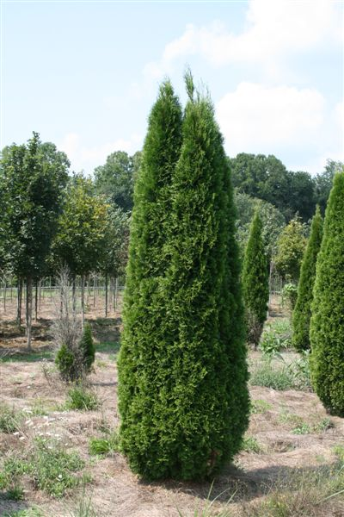

Concept Landscape Plan
Big Timber Solar Farm
Single Row of Trees and Shrubs
Serviceberry
Eastern Redbud
American Hazelnut
Shrubby St. John’s Wort
Arbor vitae
Vegetative buffer: 10-25 feet tall (typical), each tree 10-20 feet wide (typical)
Notes:
Concept Landscape plan which was created by Baxter and Woodman our environmental Consultants who are here with us today. Baxter has confirmed that all these species are native to the area and we can provide range maps to verify as well.

Slide 30
Concept Landscape Plan
Big Timber Solar Farm
Serviceberry (Amelanchier laevis): Serviceberry is an attractive understory tree, blooming white flowers in early spring. It offers both privacy and visual appeal, with low maintenance needs once established.
Eastern redbud (Cercis canadensis): Eastern Redbud is an attractive understory tree, blooming rose-purple flowers in early spring. It offers both privacy and visual appeal, with low maintenance needs once established.
American Hazelnut (Corylus americana): Hazelnut is an understory tree, blooming in early spring with small pink flowers. It offers both privacy and visual appeal, with low maintenance needs once established.
Shrubby St. John’s Wort (Hypericum prolificum): St. John’s wort is a smaller woody species. However, it blooms a bright yellow flowers in late summer. It offers visual appeal, as well as a very popular choice for bees and many other pollinators.
Arbor vitae (Thuja occidentalis): Evergreen tree is a popular choice for screening due to its dense foliage and fast growth rate. It requires minimal maintenance once established.
Techny Arbor Vitae (Thuja occidentalis “Techny”): This cultivar of Arborvitae is known for its rapid growth and tall, dense screen. It requires minimal pruning and is relatively low maintenance.

Slide 31
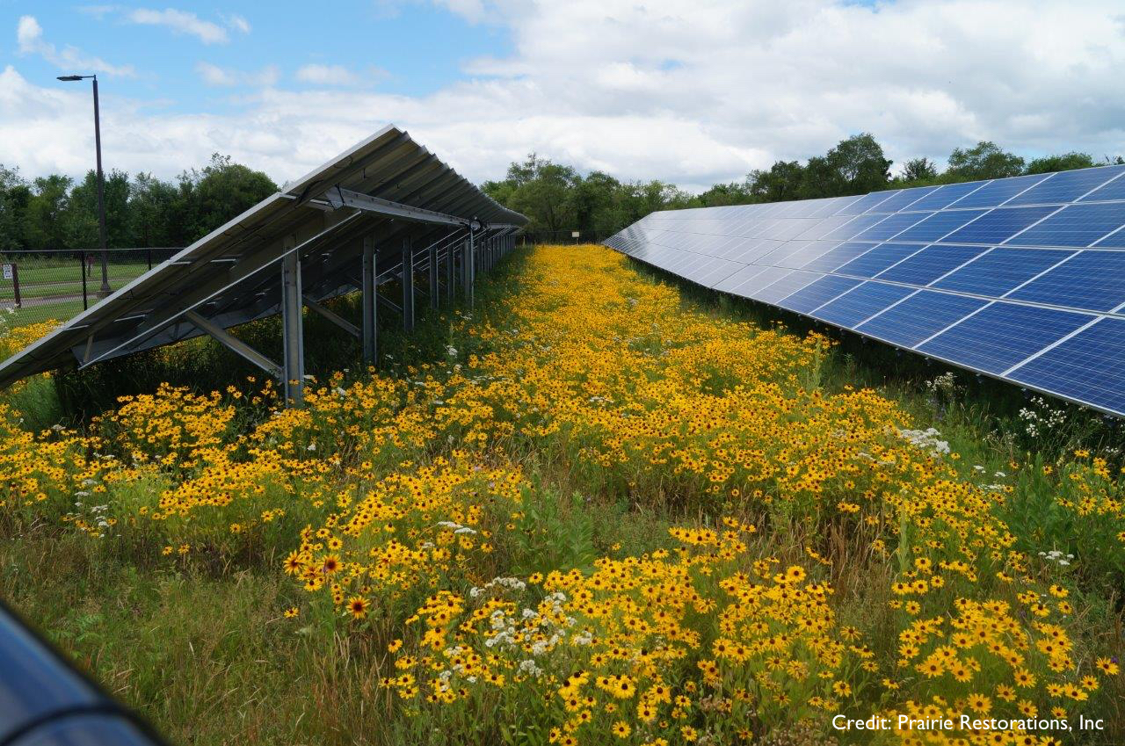
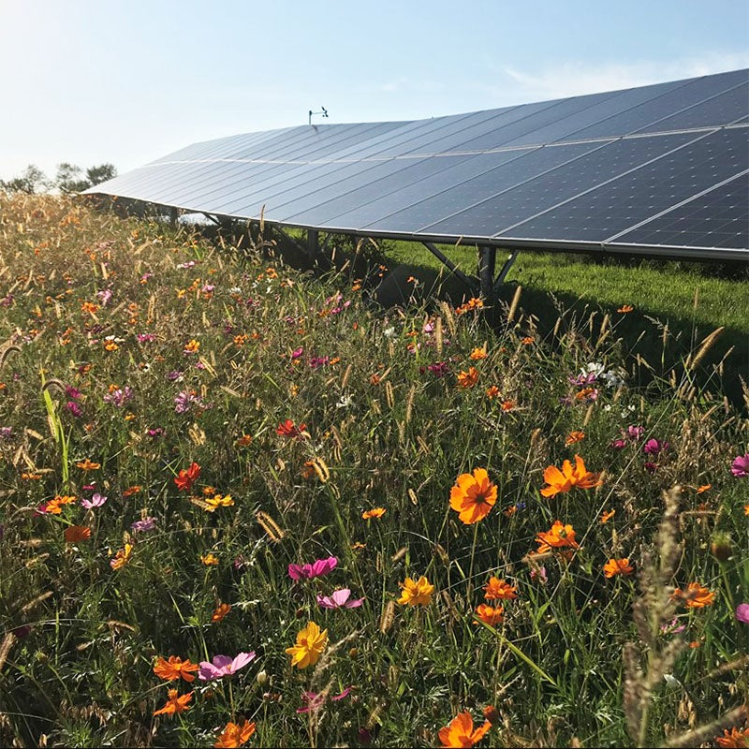
Benefits of Solar on Agricultural Fields
Big Timber Solar Farm
Solar farms preserve the land for future agricultural use, rather than permanently impacting land by development. After project lifecycle, we are required to decommission and restore the site to allow for agricultural use.
No chemicals released into the ground as fertilizer or pesticides such as ammonia and nitrogen oxides.
Native vegetation, suitable for pollinators and other species, promotes environmental sustainability.
Restores groundwater/aquifer underground.
Lowers carbon emissions via solar farm output; producing renewable energy instead of traditional power sources.
Requires low maintenance and are both safe and quiet in terms of the general public.

Slide 32
Environmental Reports
Big Timber Solar Farm
Natural Resource Inventory (NRI)
Submitted Natural Resource Inventory request to the McHenry-Lake County Soil & Water Conservation District.
The Land Evaluation Score for the parcel is 64 out of 100.
The concerns regarding the impact of solar farm development on farmland, particularly prime farmland, can be alleviated because, unlike other type of development, solar farms preserve the land for future agricultural use.
Illinois Department of Natural Resources (IDNR) State Ecological Review
Consulted with the IDNR for potential impacts to state threatened or endangered species. Consultation conducted on IDNR’s Ecological Compliance Assessment Tool (EcoCAT).
Consultation terminated with the following result:
      “The Illinois Natural Heritage Database contains no record of State-listed threatened or endangered species, Illinois Natural Area Inventory sites, dedicated Illinois Nature Preserves, or registered Land and Water Reserves in the vicinity of the project location.”

Slide 33
Environmental Reports
Big Timber Solar Farm
U.S. Fish and Wildlife (USFWS)
Project’s potential to impact federally protected species was evaluated.
We have initiated a letter in IPaC, we currently have a species list of the subject parcel.
Illinois State Historic Preservation Office
Review completed Under the Illinois State Agency Historic Resources Protection Act, IDNR’s Illinois State Historic Preservation Office (SHPO) identifies possible effects on archeological or architectural (cultural) resources.
Said review indicated, “Our files do not identify any known historic properties within the high probability area for archeological resources as defined in the stated Act. Accordingly, this project is EXEMPT pursuant to the Illinois State Agency Historic Resources Preservation Act (20 ILCS 3420/6). An archeological survey for your above referenced project is not required under state law.”

Slide 34
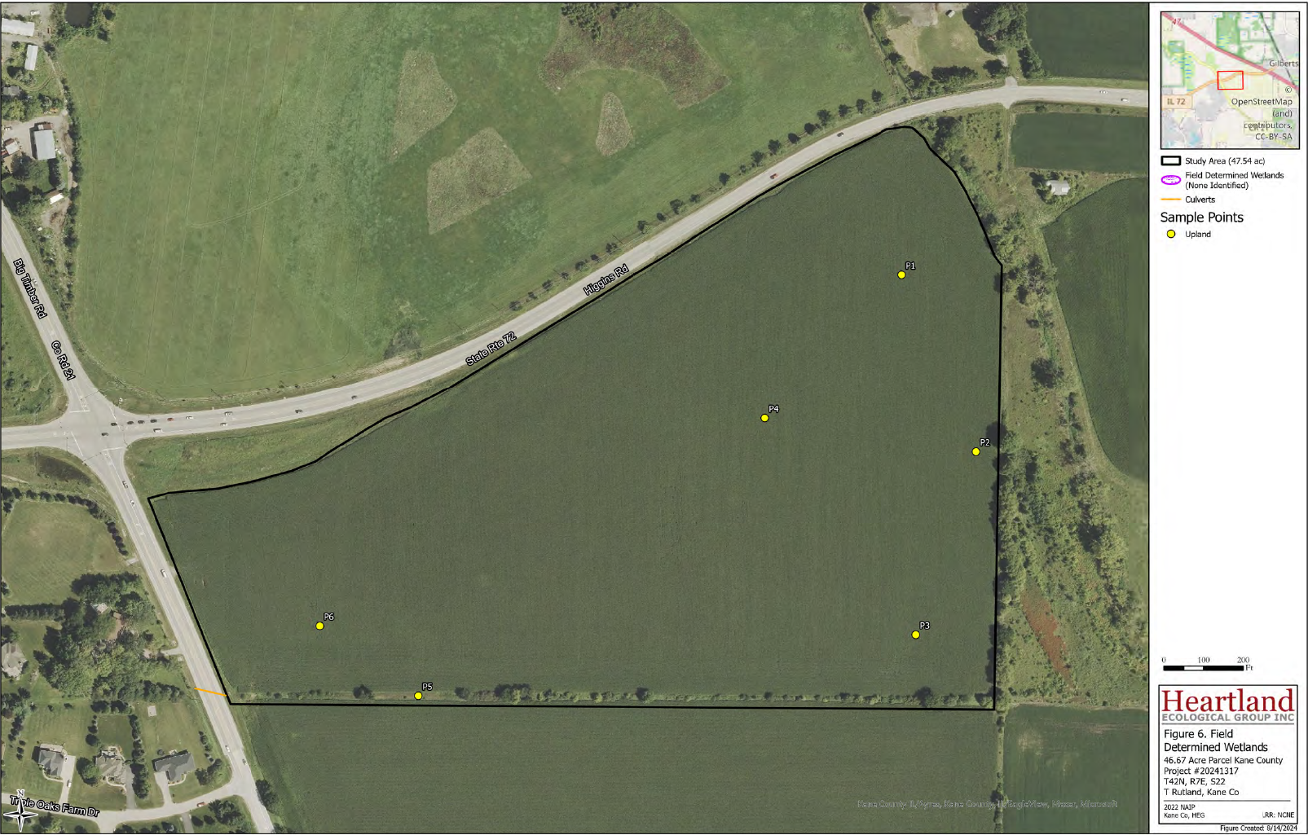
Environmental Reports
Big Timber Solar Farm
Wetland Delineation Report
Zero wetlands were identified onsite

Slide 35
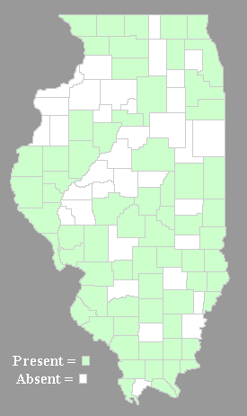
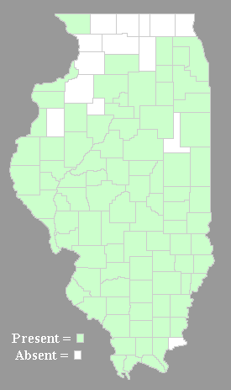
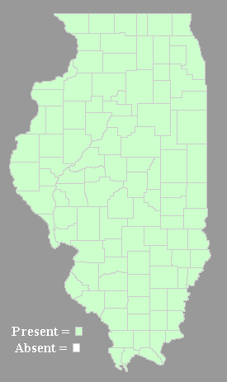
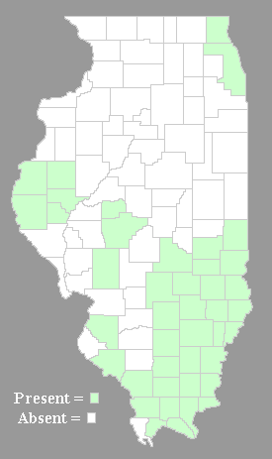
Concept Landscape Plan – Range Maps
Big Timber Solar Farm
Serviceberry
Eastern Redbud
American Hazelnut
Shrubby St. John’s Wort
Vegetative buffer: 10-25 feet tall, each tree 10-20 feet wide

Slide 36
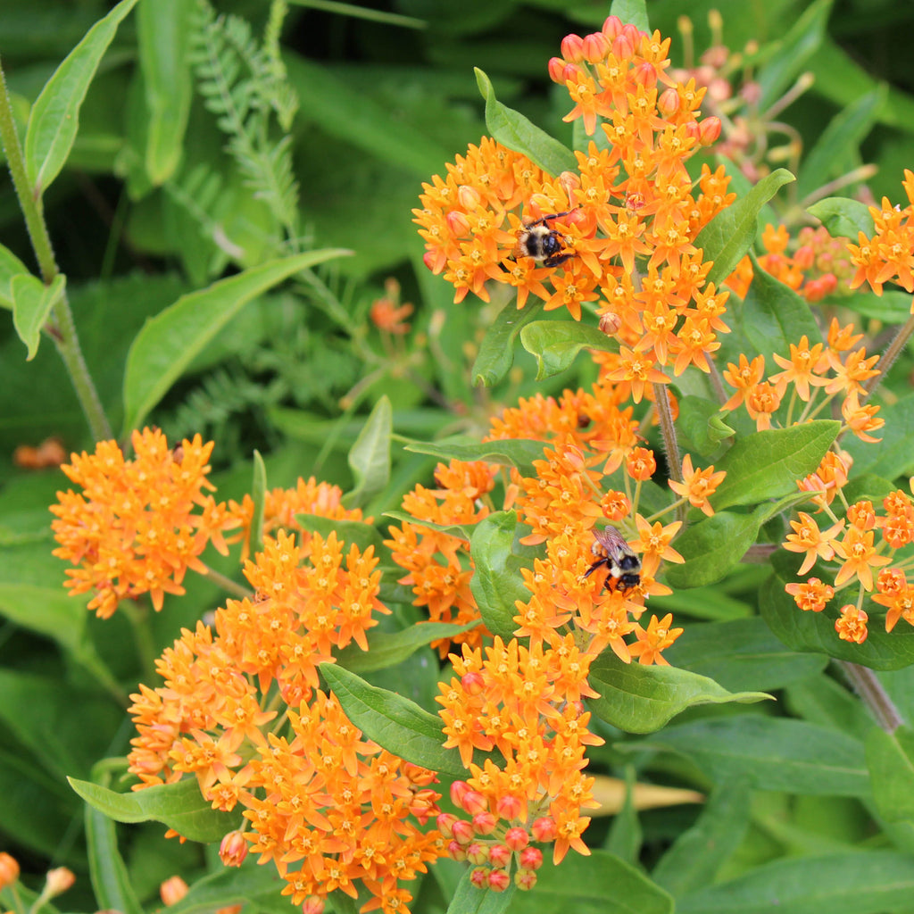
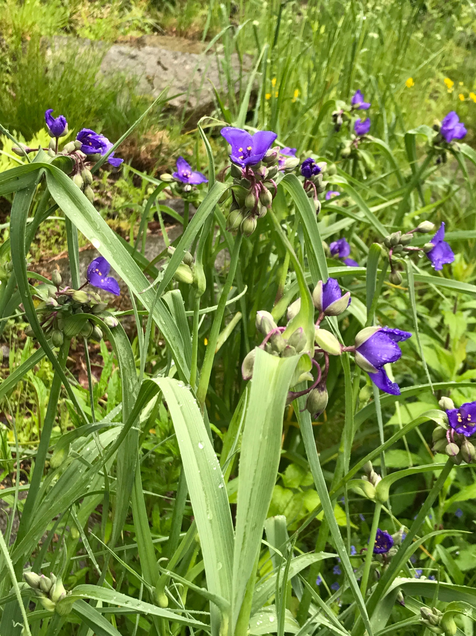
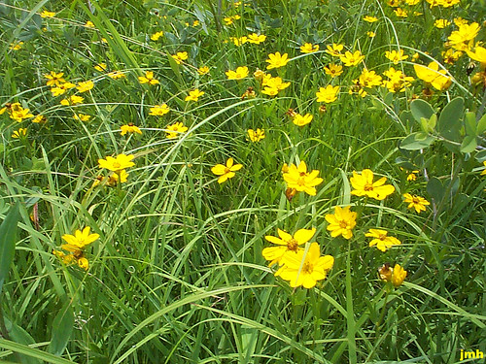
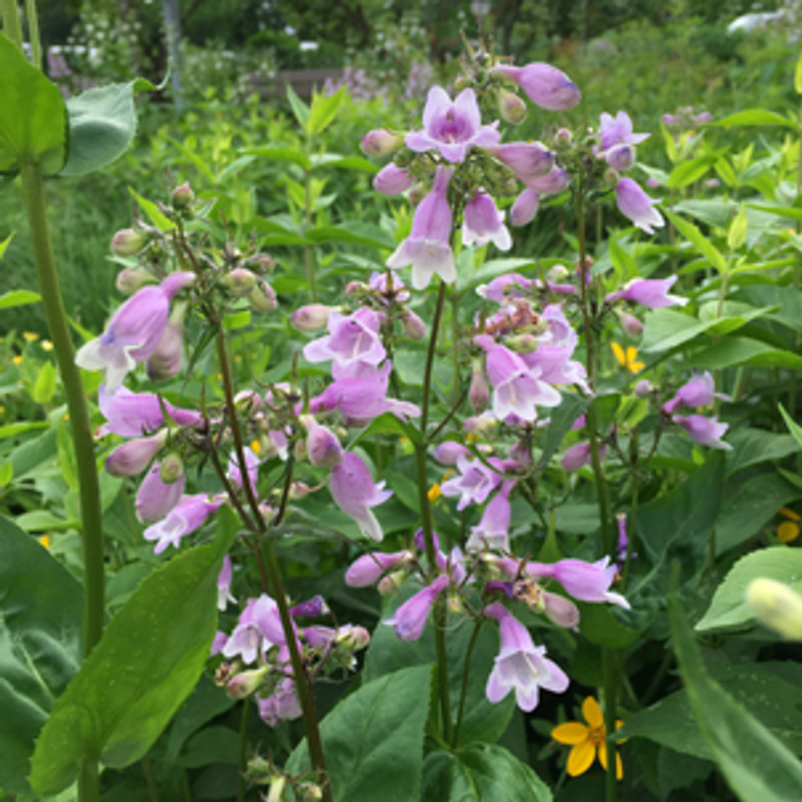
Preliminary Vegetation Plan
Big Timber Solar Farm
As part of the final plan, we will include:
Planned plant diversity in rows and beneath solar arrays.
Seeds used for native perimeter and buffer areas.
Planned number of native species in perimeter and buffer areas.
Planned percentage of perimeter buffer area dominated by native plant species.
Planned percentage of site vegetation cover to be dominated by desirable wildflowers.
Habitat site preparation prior to implementation.
Butterfly Milkweed
Spiderwort
Stiff Coreopsis
Calico Beardtongue

Slide 37
Proposed Seed Mixtures
Big Timber Solar Farm
MESIC PRAIRIE BUFFER SEED MIXTURE
Scientific name | Common Name | Oz./Acre | lbs./Acre
Grasses & Sedges:
Bouteloua curtipendula | Side oats grama | 65.3
Carex bicknellii | Copper-shouldered oval sedge | 5.5
Panicum virgatum | Switch grass | 14.5
Schizachyrium scoparium | Little bluestem | 89.1
Total Grasses |  | 174.5 | 10.9
Forbs:
Asclepias tuberosa | Butterfly milkweed | 7.5
Coreopsis palmata | Stiff coreopsis | 4.4
Echinacea pallida | Pale purple coneflower | 15.7
Echinacea purpurea | Purple coneflower | 7.9
Eryngium yuccifolium | Rattlesnake master | 6.5
Heliopsis helianthoides | False sunflower | 4.0
Liatris pycnostachya | Prairie blazing star | 2.4
Monarda fistulosa | Wild bergamot | 0.7
Oligoneuron rigidum | Stiff goldenrod | 1.1
Penstemon digitalis | Foxglove beard tongue | 0.4
Petalostemum purpurea | Purple prairie clover | 3.9
Rudbeckia hirta | Black-eyed Susan | 1.0
Ratibida pinnata | Yellow coneflower | 2.1
Rudbeckia subtomentosa | Sweet black-eyed Susan | 1.7
Symphyotrichum oolentangiense | Sky blue aster | 1.0
Tradescantia ohiensis | Spiderwort | 5.0
Zizia aurea | Golden Alexanders | 1.6
Verbena stricta | Hoary vervain | 1.6
Total Forbs |  | 68.5 | 4.3
Total All Species |  | 243.0 | 15.2
Temporary Cover Crop:
Avena sativa | Common oats | 320.0 | 20.0
Elymus canadensis | Canada wild rye | 8.0 | 0.5
SHORT STATURE POLLINATOR PRAIRIE SEED MIXTURE
Scientific name | Common Name | Oz./Acre | lbs./Acre
Grasses, Sedges, & Rush:
Bouteloua curtipendula | Side oats grama | 65.3
Carex bicknellii | Copper-shouldered oval sedge | 3.3
Carex vulpinoidea | Brown fox sedge | 3.3
Juncus tenuis | Path rush | 0.1
Schizachyrium scoparium | Little bluestem | 80.2
Sporobolus heterolepis | Prairie dropseed | 9.3
Total Grasses |  | 152.3 | 9.5
Forbs:
Allium cernuum | Nodding wild onion | 6.9
Asclepias tuberosa | Butterfly milkweed | 11.2
Asclepias verticillata | Whorled milkweed | 3.6
Coreopsis palmata | Stiff coreopsis | 6.6
Coreopsis lanceolata | Sand coreopsis | 5.6
Penstemon calycosus | Calico Beardtongue | 0.5
Petalostemum purpurea | Purple prairie clover | 5.2
Rudbeckia hirta | Black-eyed Susan | 1.2
Solidago nemoralis | Old Field Goldenrod | 0.3
Symphyotrichum ooelntamgiense | Sky Blue Aster | 1.1
Tradescantia ohiensis | Spiderwort | 9.9
Zizia aurea | Golden Alexanders | 2.5
Verbena stricta | Hoary vervain | 2.5
Total Forbs |  | 57.0 | 3.6
Total All Species |  | 209.2 | 13.1
Temporary Cover Crop:
Avena sativa | Common oats | 320.0 | 20.0

Slide 38
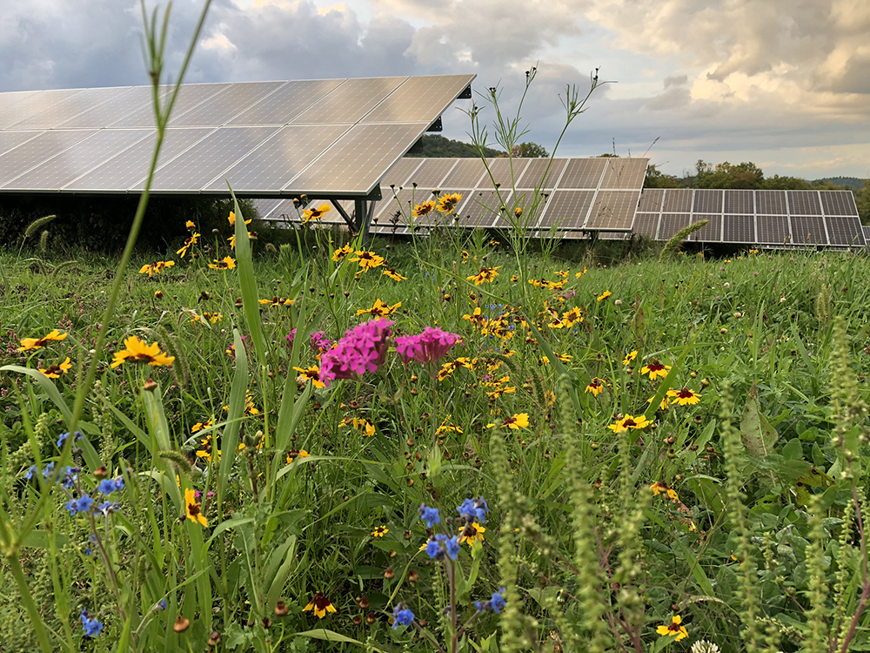
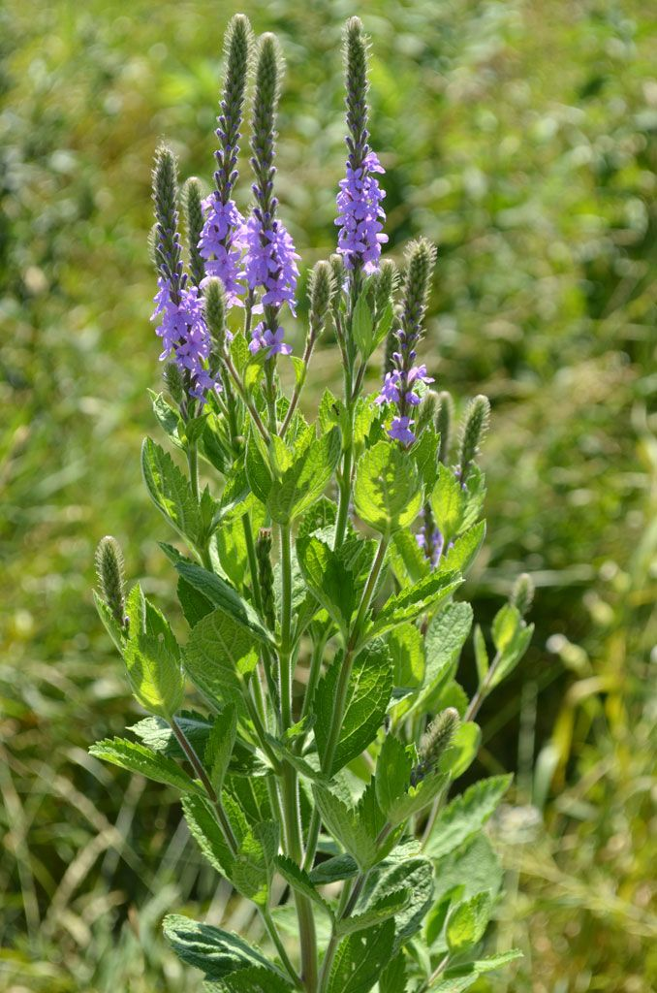
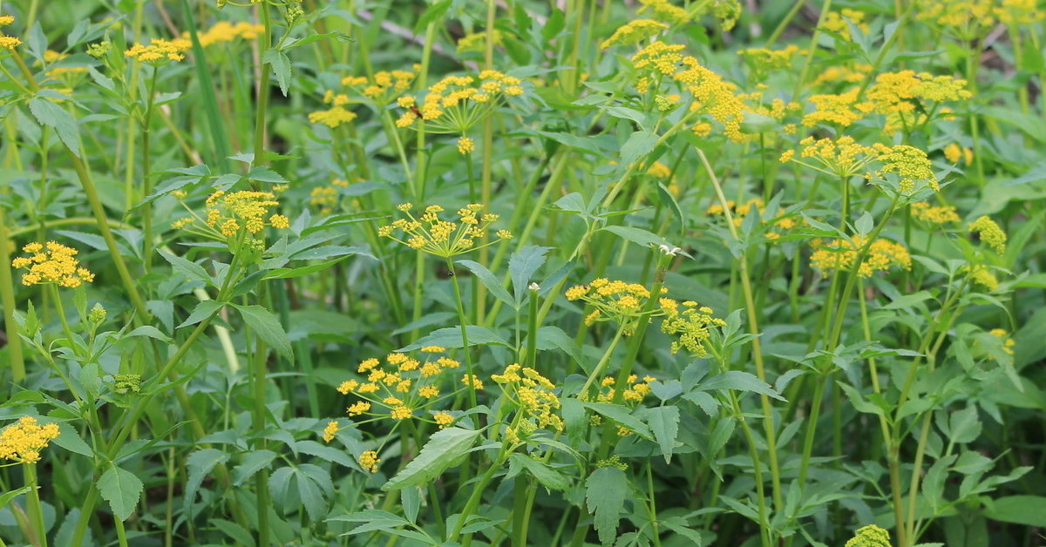
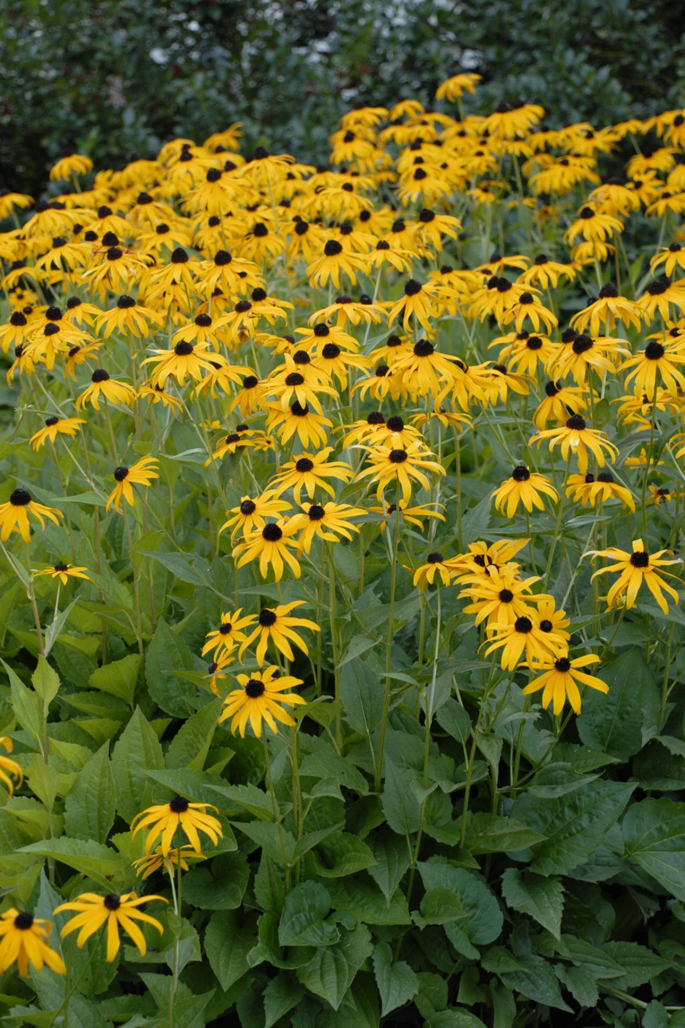
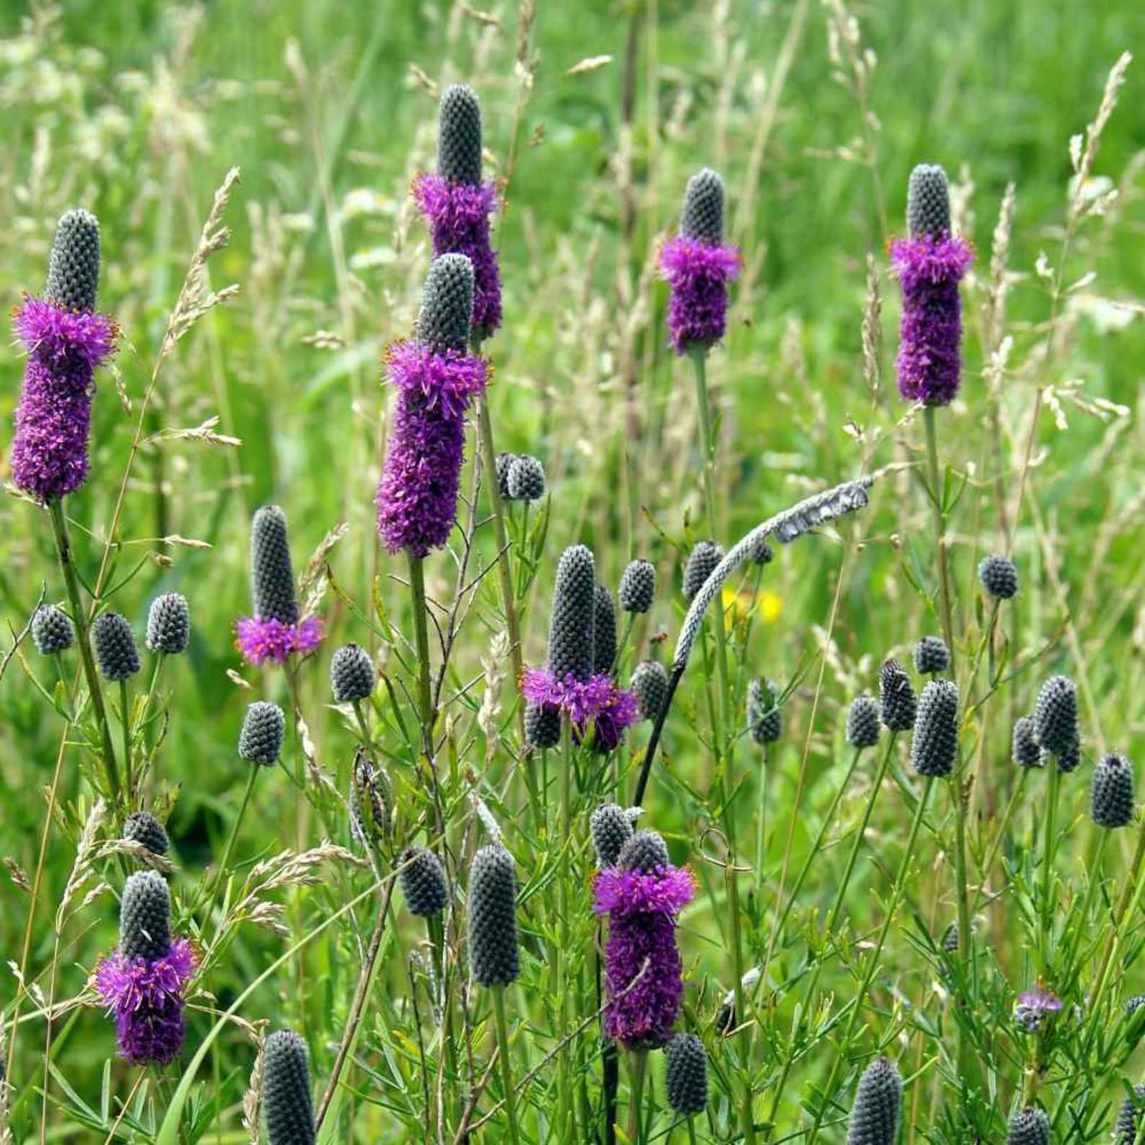
Pollinators on Solar Farm
Big Timber Solar Farm
Hoary Vervain
Golden Alexanders
Black-eyed Susan
Purple Prairie Clover

Slide 39
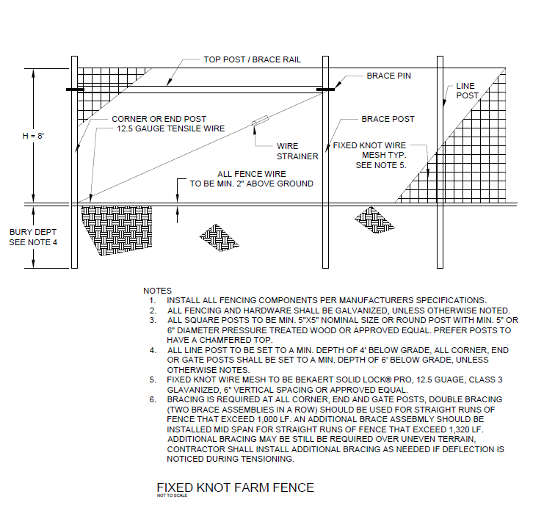
Fence
Big Timber Solar Farm
Notes:
Landscape screening plan

Slide 40
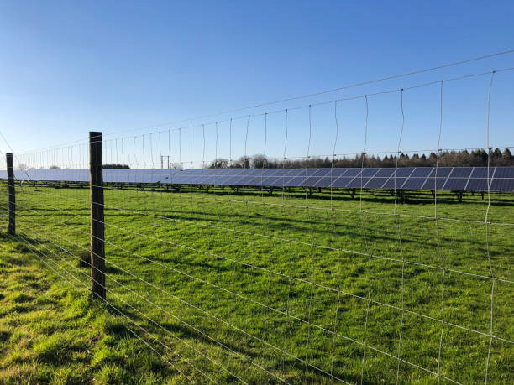
Fixed Farm Knot Fence
Big Timber Solar Farm

Slide 41
Decommissioning
Big Timber Solar Farm
Decommissioning of the Big Timber Solar Farm will be carried out in the reverse order of installation:
The solar system will be disconnected from the utility power grid.
PV modules will be disconnected and removed.
Electrical cables will be removed and recycled off-site.
PV module racking will be removed and recycled off-site.
PV module support posts will be removed and recycled off-site.
Electrical devices, including transformers and inverters, will be removed, and recycled off-site.
Concrete pads will be removed and recycled off-site.
Fencing will be removed and recycled off-site.
Soils in the access driveway and equipment pad areas will be reclaimed by removing imported aggregate material and concrete foundations and replacing them with soils as needed.
Big Timber Solar Farm Commitments
Big Timber Solar Farm has prepared the required estimates using current cost projections and will complete a decommissioning bond with Kane County for the required surety amount. Said surety will be updated periodically over the project lifespan to comply with County requirements
The project’s AIMA agreement with IDOA requires Developers restore the site back to agricultural use including the repair or replacement of drain tiles damaged through construction or decommissioning. A drain tile survey will be completed prior to the start of construction.
Decommissioning Operations
All equipment will be removed and transported to a central location for decommissioning and recycling, if possible.
Decommissioning will occur after the life cycle of the project (30 years).
Decommissioning takes about 90 days to complete (weather permitting).

